Slide 1
MINI PROJECT
HELPING HANDS
MENTOR: ANAND GUPTA
TEAM MEMBERS:
ABHISHEK GUPTA (01)
AKANSHA GUPTA (04)
ANUSHKA MAHESHWARI (07)

Slide 2
INTRODUCTION
Helping Hand will show the ability of NGOs related activities via this application. NGOs are performing activity for helping purpose . A non governmental organization is a non-profit organization that is independent from states and international government. NGOs are highly diverse groups of organizations engaged in a wide range of activities and take different forms in different parts of the world. some may have charitable status. while others may be fonts for political, religious, or other interest. They are usually funded by donations but some avoid formal funding together and are primarily by volunteers. Helping Hand is NGO related activity via this application, people who are really want to help someone but they cant. now they can help them with this online HELPING HANDS application .

Slide 3
PROJECT OBJECTIVE
1. Creating NGO Awareness – Building awareness for NGO was the primary goal. The various campaigns run by the NGO lacked online visibility. It was essential to boost the online presence of the NGO.
2. Approach existing donors for donations – Reach out to existing donors, who are in touch with the NGO in the past and approach them for funding the exiting & upcoming projects of the organizations.
3. Look for new leads by carrying out field visits – Look for potential leads or corporates who would be willing to tie up with the organization for various CSR activities.

Slide 4
TRCHNOLOGY USED
SYSTEM REQUIREMENTS
HARDWARE REQUIREMENTS
HTML
CSS
JAVASCRIPT
PHP
RAM 2 GB AND ABOVE.
INTEL PANTIUM PROCESSOR & ABOVE.
NORMAL GRAPHIC CARD.
SOFTWARE REQUIREMENTS
No Such Software Requirement only a web browser( like GOOGLE CHROME ).

Slide 5
PROBLEM & CHALLANGES
There were certain issues that were highlighted at the NGO
• The organization lacked awareness.
• The website was not listed on the first page of Google Search.
• Different searches for NGO or CSR were unable to get the website on the first page.
• The actual projects were not being highlighted as the stories were not highlighted efficiently.
• The organization lacked tracking of the corporate leads.
• The corporate funding questionnaire was not efficient to capture the complete data.
• The organization lacked awareness among corporates.
• There was a need to reach to corporates in person to present the projects undergone in SAATH and pitch in for long term tie ups.

Slide 6
ADVANTAGES
DISADVANTAGES
1.A donation is done to hand to hand with donors.
2.Event details will be sending through via news.
3.This project is for offline or online donors.
4.this system accept all type of donations. ex-toys, cash, clothes, etc.
1.Registered member can see information only on helping hand site.
2.user cannot directly contact.contact should be done only with site.

Slide 7
PROJECT OVERVIEW

Slide 8
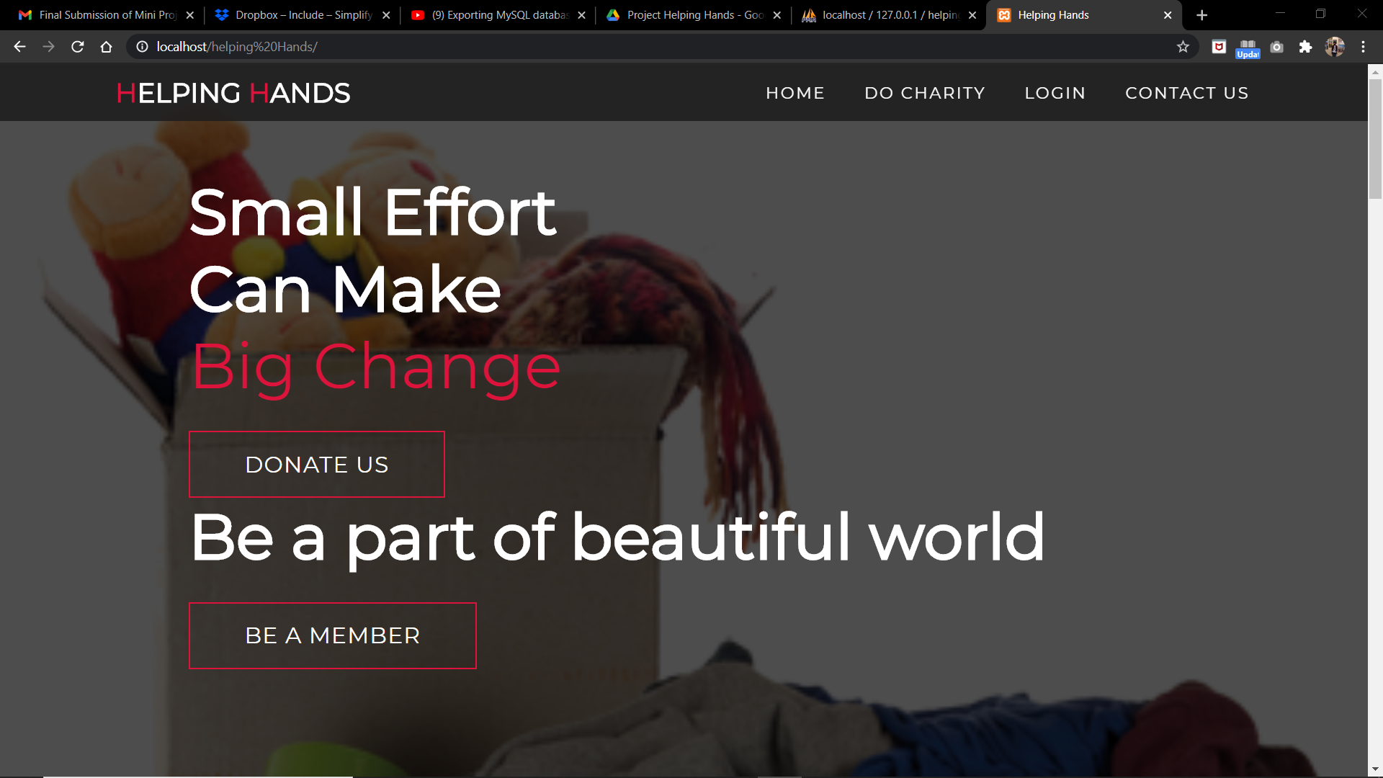

Slide 9
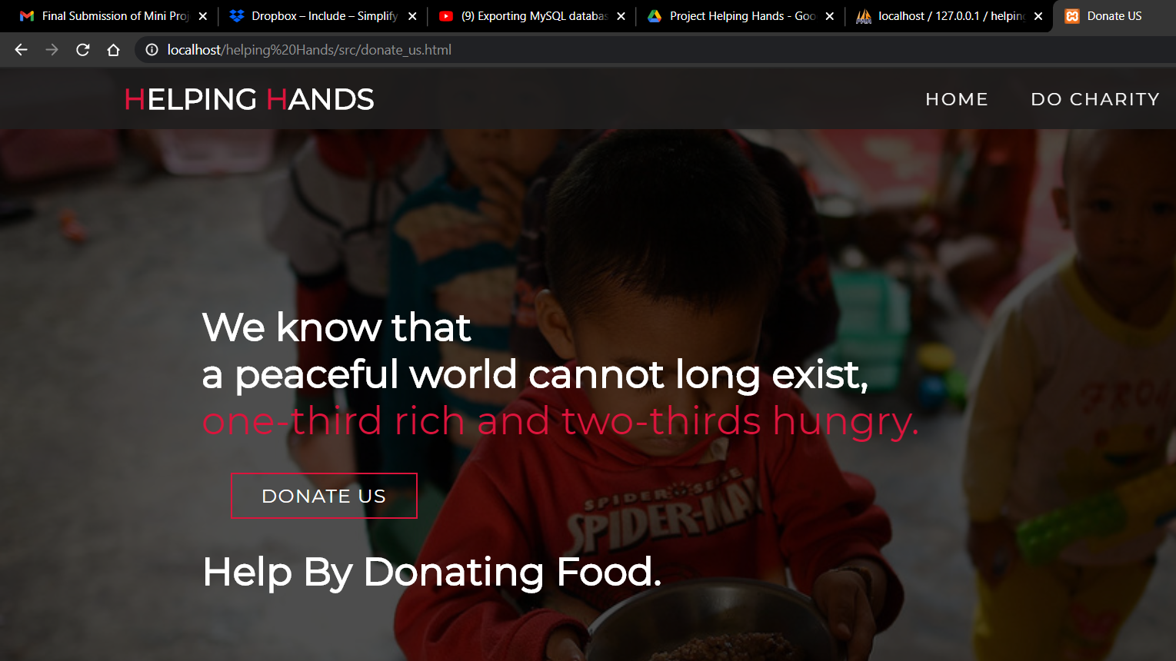

Slide 10
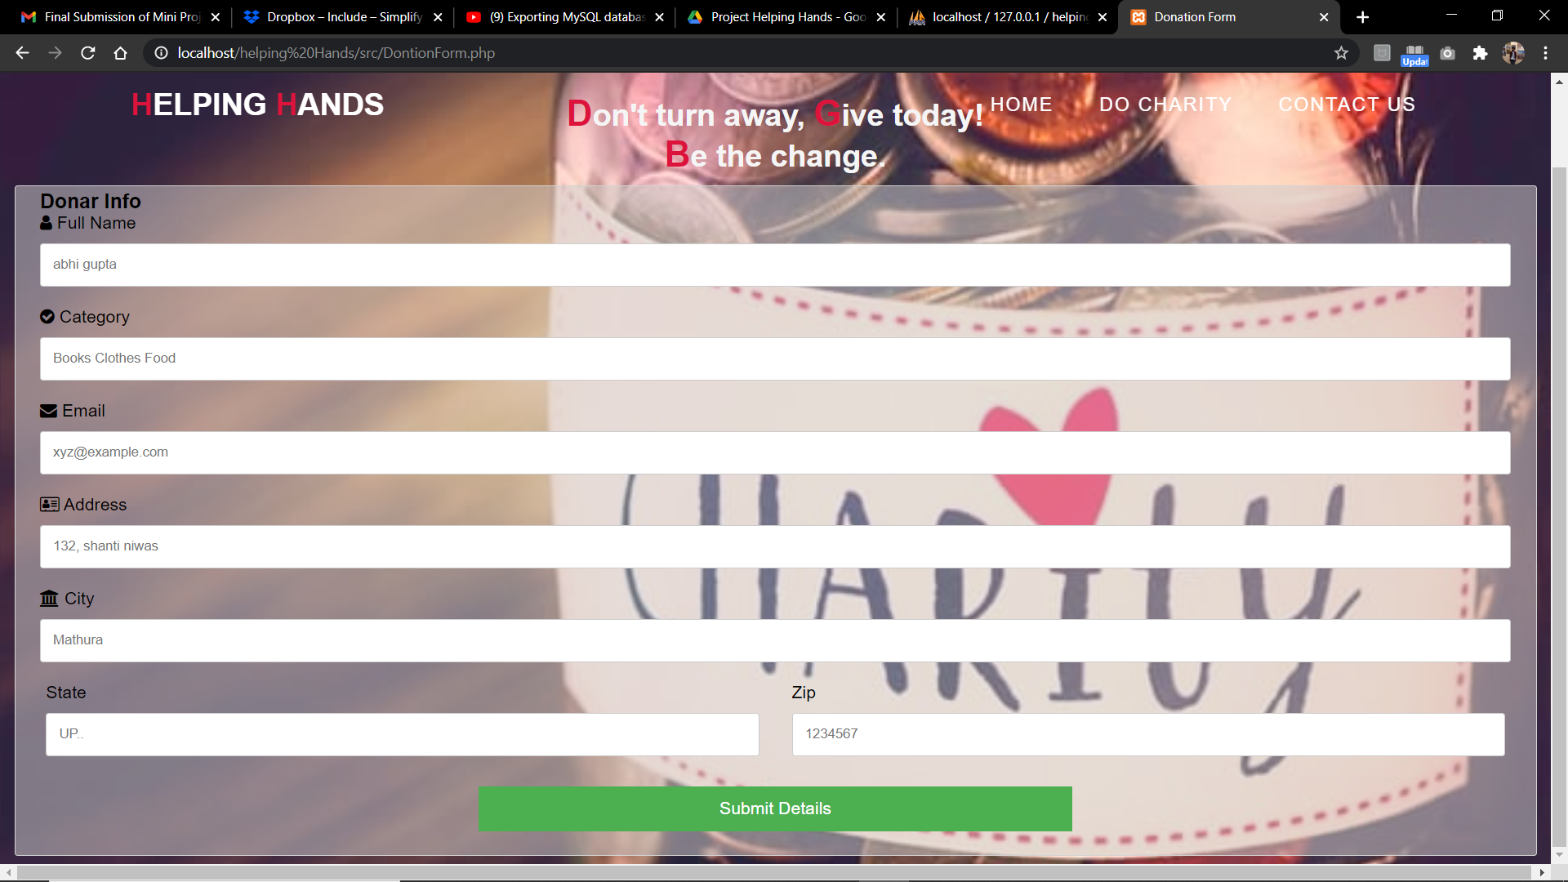

Slide 11
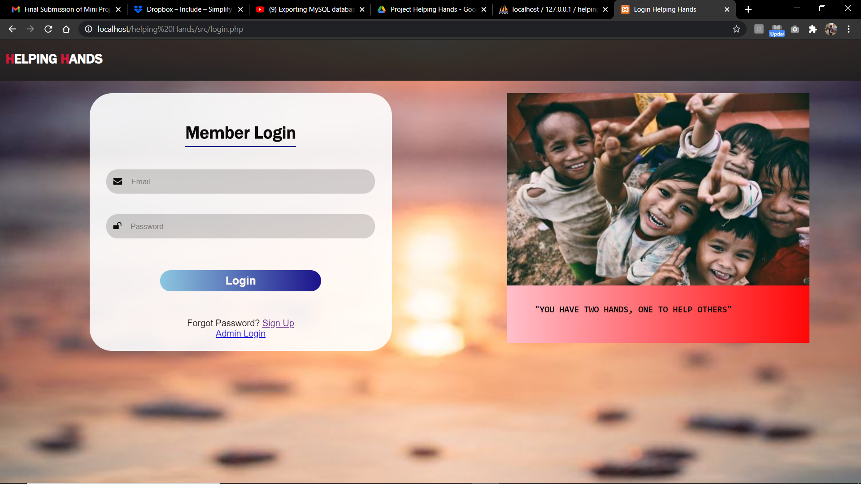

Slide 12
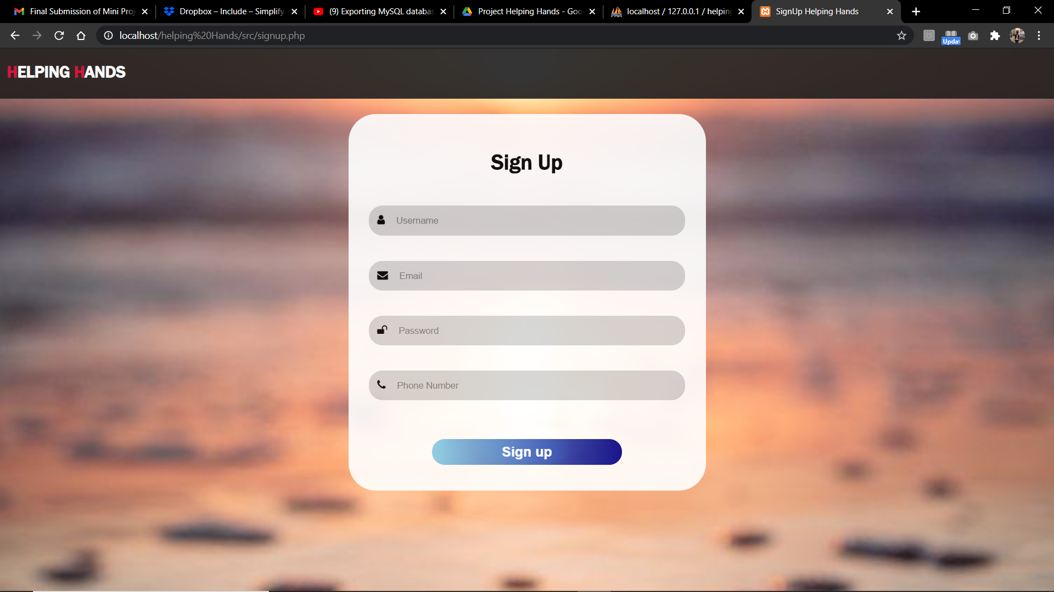

Slide 13
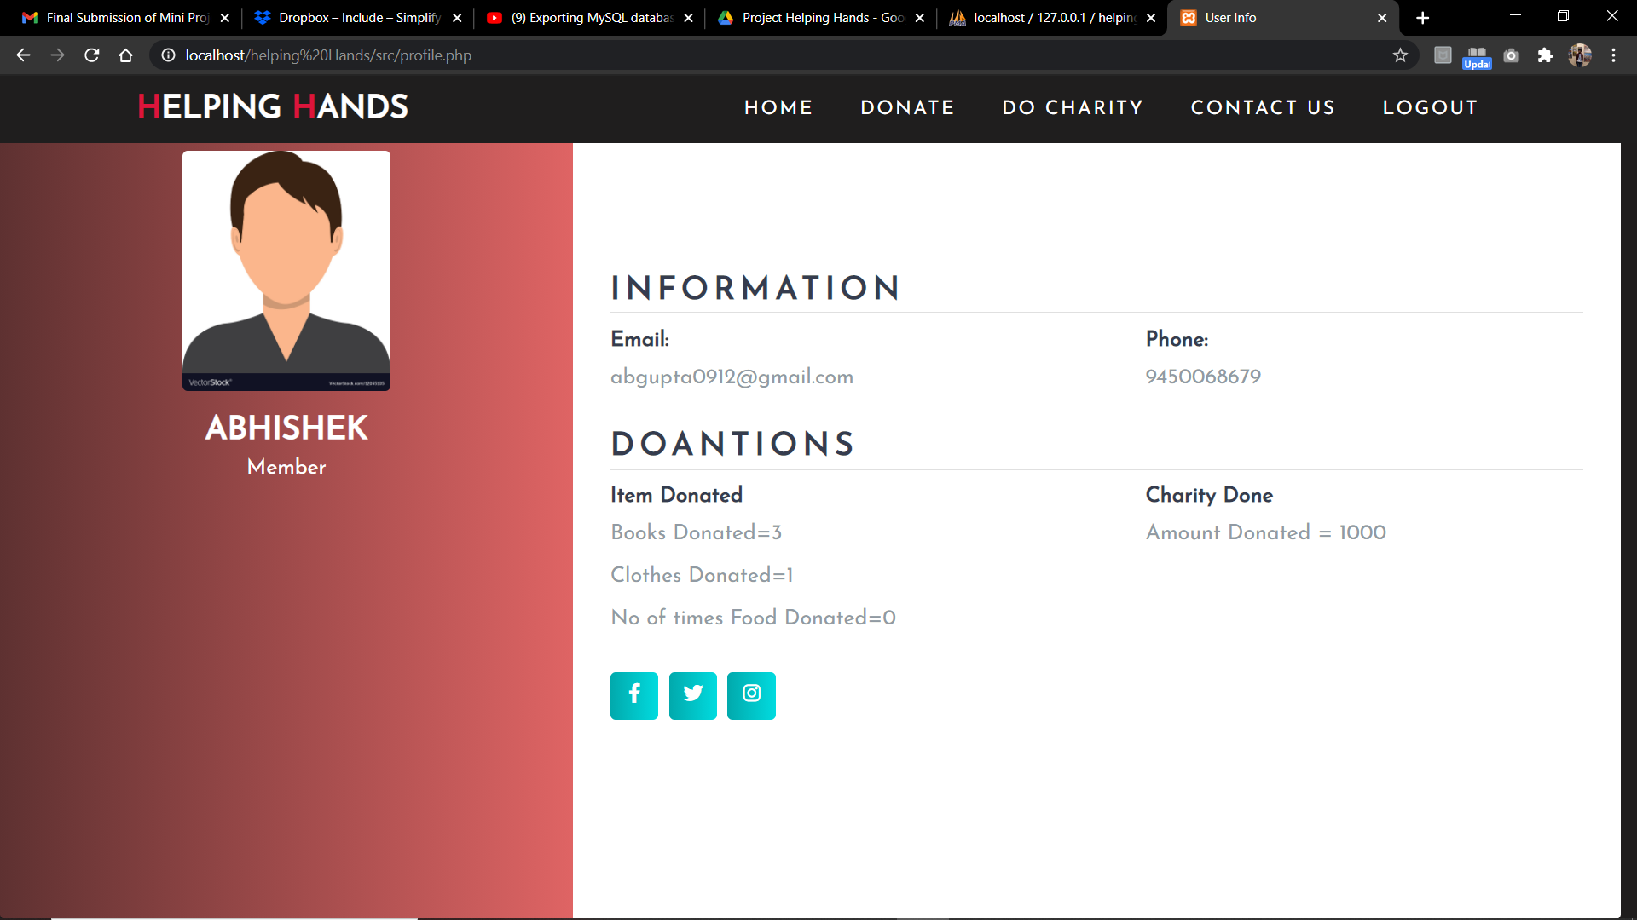

Slide 14
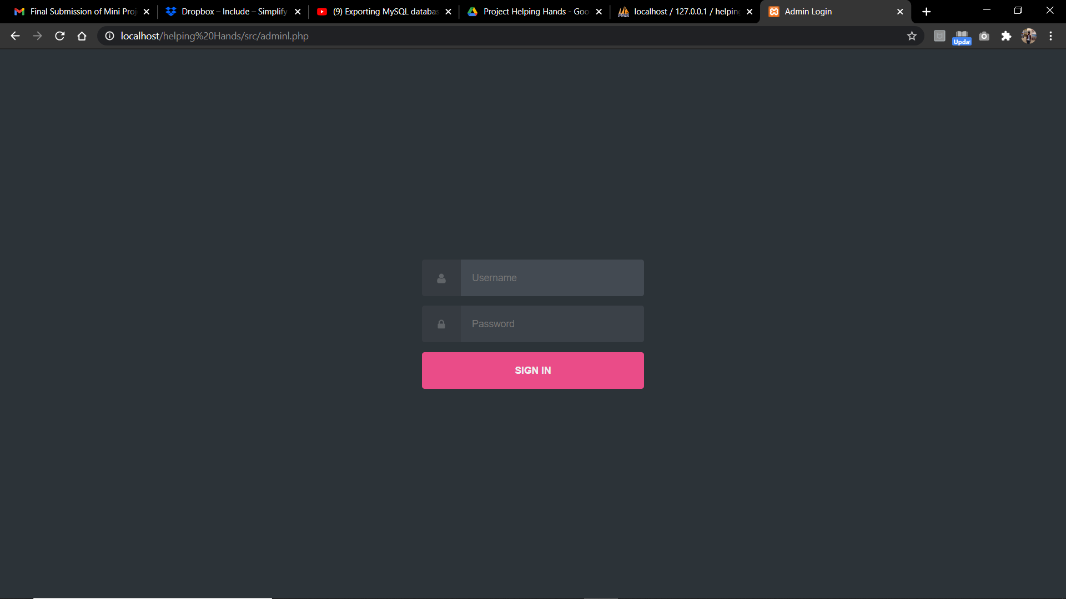

Slide 15
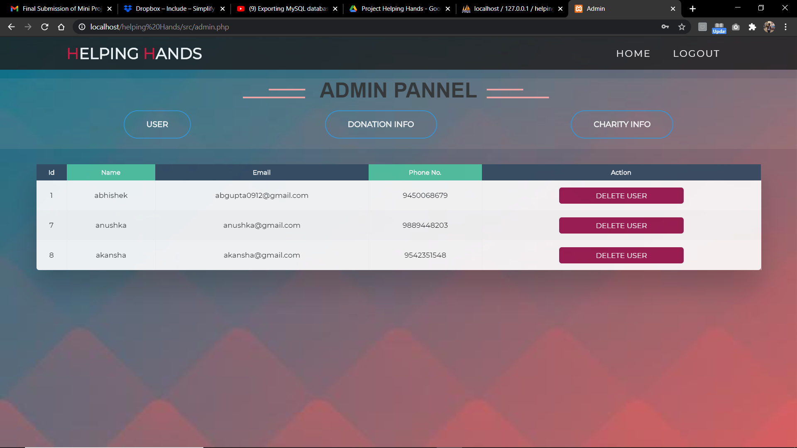

Slide 16
FEATURES
1. Easy-to-Read Layout
2. A Big Join or Donate Button
3. A Clear Call to Action
4. Concise Copywriting Which Motivates Action
5. Friendly, Welcoming Design
6. Offer different giving amounts.
7. Include social media info.

Slide 17
CONCLUSION
Poverty and hunger are the main problem of our country. There are so many websites that are working to minimize poverty and hunger in society. These websites take donations for this purpose and arrange fund raising events/ processes so that everyone can donate anything.so, our website will be able to take these things and help society in a way that:
The system have a user registration process and this registration will be for two perspectives
For those who want to donate.
For those who want to volunteer.
The user can make an online donation.
The system send a confirmation email to the donor after successful donation.
User can donate tangible things also.
The system can import online donations and donor records from the website.
The system can track fundraising campaigns and donations.

Slide 18
THANK YOU

